Slide 1
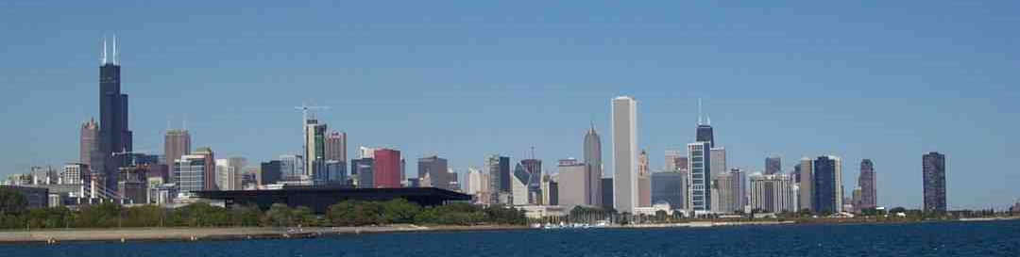
How Can we Evacuate Individuals with Disabilities from High Rise Buildings Safely and Efficiently?
Steve Lavender, PhD¹
Glenn Hedman, MS²
Jay Mehta, MS¹
Sanghyun Park, MS¹
Paul Reichelt, PhD²
Karen Conrad, PhD²
¹The Ohio State University
²The University of Illinois at Chicago

Slide 2
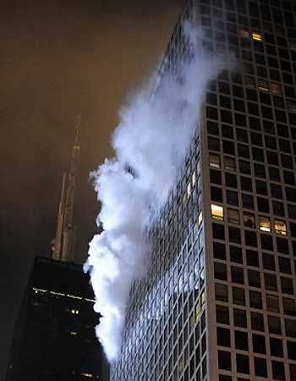
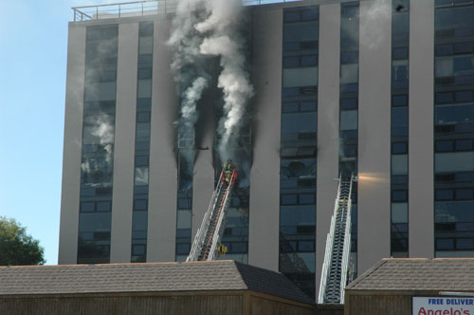
Evacuation Needs
http://highriseoperations.com/2012/04/truck-company-operations-at-high-rise-fires/
http://www.foxnews.com/story/0,2933,579922,00.html

Slide 3
EMS – An occupation with Significant MSD Risks
Maguire, B.J., Hunting, K.L., Guidotti, T.L., & Smith, G.S. (2005). Occupational injuries among emergency medical services personnel. Prehospital Emergency Care, 9, 405-411.
  Relative risk: 5.8 relative to health services
Gershon RR, Vlahov D, Kelen G, Conrad B, Murphy L. (1995) Review of accidents/injuries among emergency medical services workers in Baltimore, Maryland. Prehosp Disaster Med., 10:14-18.
  43% Strains/Spains, 20% of injuries to the back
Hogya PT, Ellis L. (1990). Evaluation of the injury profile of personnel in a busy urban EMS system. Am J Emerg Med. 8:308-11.
  Back strain accounted for 78% of lost days.

Slide 4
EMS – An occupation with Significant MSD Risks
Haynes, H.J.G., Molis, J.L., 2017. United States Firefighter Injuries – 2016, National Fire Protection Association, NFPA No. FFI10.
  Sprains, strains, and muscular pain account for 60% of the injuries suffered by firefighters while performing non-fire emergency tasks, such as EMS and other rescue operations
Furber, S., Moore, H., Williamson, M., Barry, J. (1997). Injuries to ambulance officers caused by patient handling tasks. J. Occup Health Safety, 13, 259-265.
  Most common location – private residence where stairs and heavy patients are contributing factors.
  63% of injuries were back injuries

Slide 5
Study Objective
To evaluate different types of stair descent devices that can be used to evacuate individuals with motor disabilities from high-rise buildings.
  Biomechanical Demands
  Physiologic Demands
  Efficiency

Slide 6
Prior Work
Adams and Galea (2010)
  Decreased task performance times when using a track-type device vs:
    manually carried stair-chair,
    an ambulance cot,
    or a drag mattress
The physical demands on the responders were not quantified.
Adams and Galea, 2010, Pedestrian and Evacuation Dynamics Conference, NIST, Maryland USA

Slide 7
Track-Chair Comparison Study
Fredricks et al., 2006
  Compared two track chairs
  Modeled with the 3DSSPP
  Substantial differences between two track-type chairs
    Spine Compression
    Spine Shear
  Used two operators (leader/follower)
    Load sharing
Fredericks, T.K. et al. (2006). Proceedings of the 11th annual international conference on industrial engineering- Theory, applications, and practices, Nagoya, Japan

Slide 8
Study Aims
To quantify the differences among types of existing evacuation devices with regards to the physical demands placed on firefighters.
To quantify the variation in evacuation times, including occupant preparation for transport and the stair descent process, across different evacuation devices.

Slide 9
Study Aims (Continued)
To determine the impact of environmental factors including:
  the width of the stairs,
  the sense of urgency,
To assess usability issues with each of the evaluated devices through video analysis and a structured interview process.

Slide 10
Study Aims (Continued)
To understand the consumer’s perspective.

Slide 11
Approach
11
Evaluate physical demands experienced by seasoned FF as they roll/slide stair descent devices down flights of stairs.
Physical Demands are measured using:
    Electromyography (EMG)
    Heart Rate
    Self Report

Slide 12
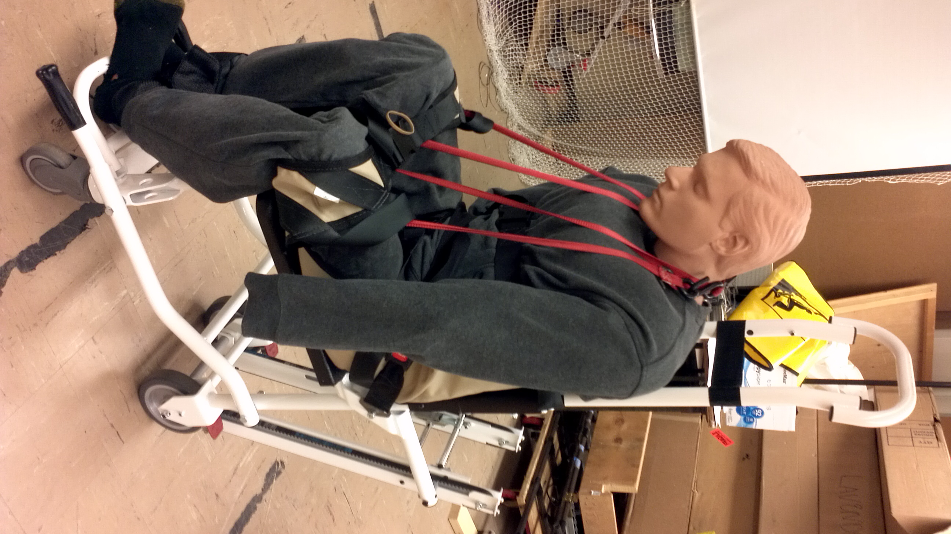
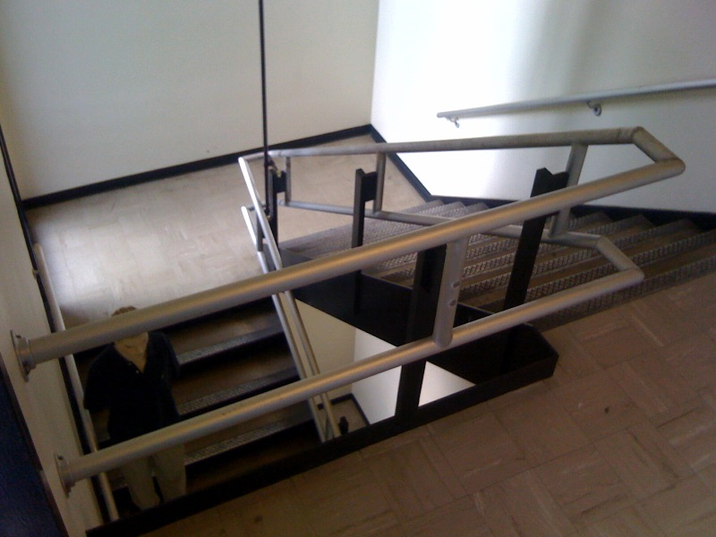
Task
Secure occupant in device
Transport the occupant down three flights of stairs.
  Through two landings
12

Slide 13
Experimental Design
13
Factors considered
  Device Design
  Staircase Width
  Urgency

Slide 14
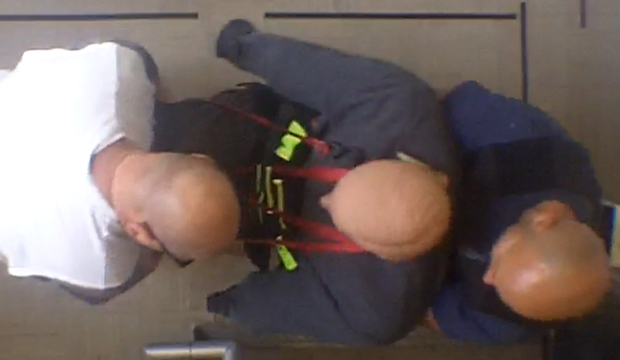
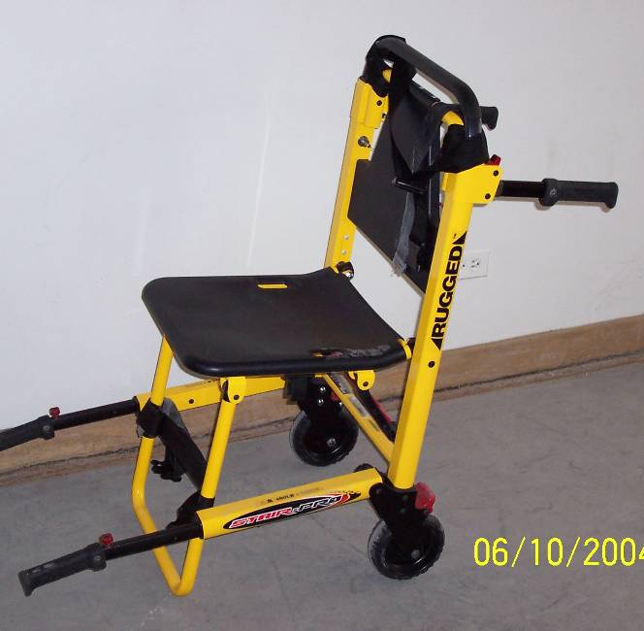
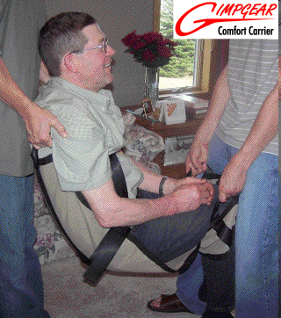
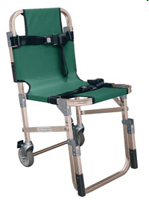
Device Type
3 Main Categories
  Hand-carried devices
  Devices with stair descent tracks
  Sled type devices
14
Notes:
Hand carried devices shown here- Clockwise from the top: top view of manual carry, extended handle, basic stairchair, fabric seat

Slide 15
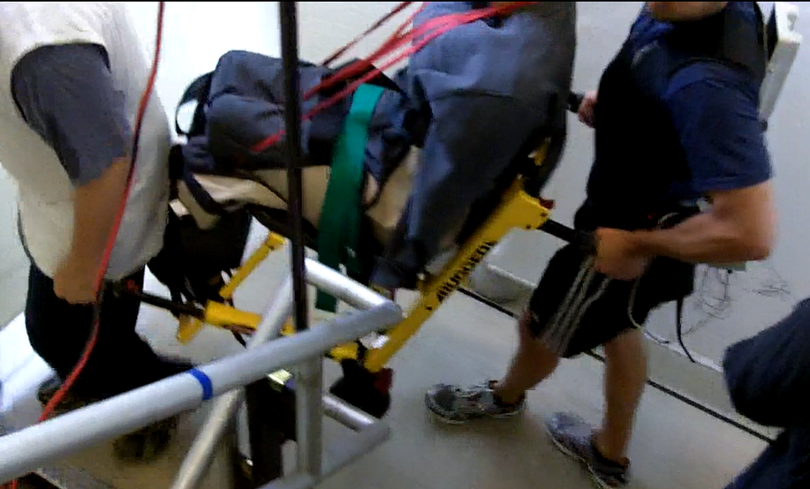
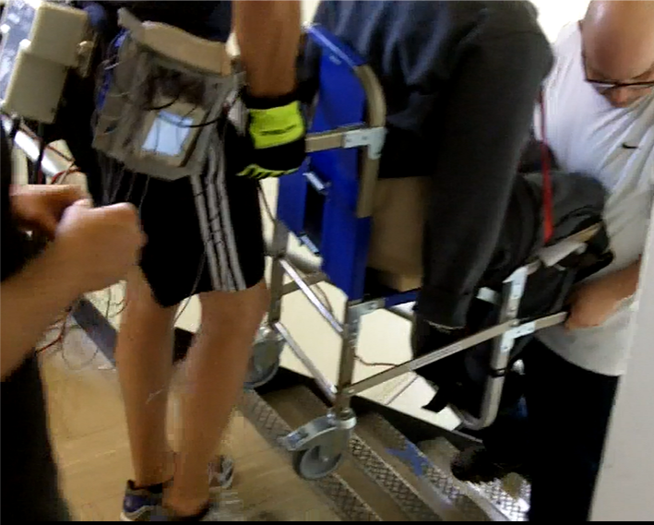
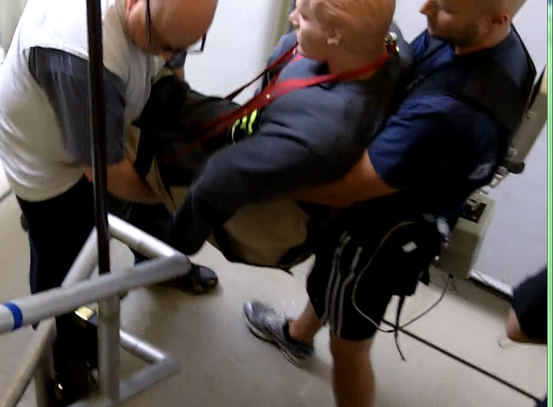
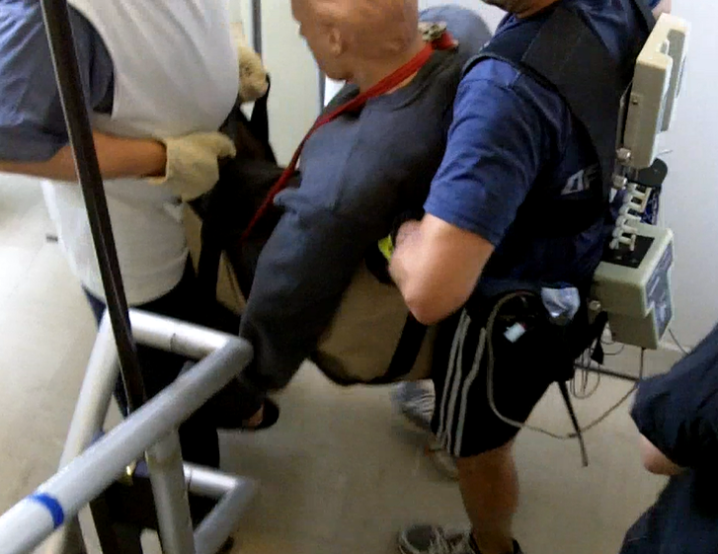
Basic Stairchair
Extended Handle Stairchair
Manual Carry
Fabric Seat
15
Notes:
Pictures showing use of the hand-carried devices and the manual carry

Slide 16
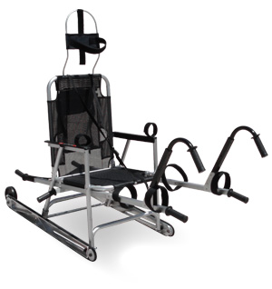
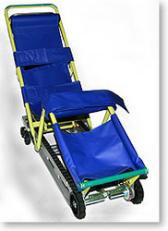
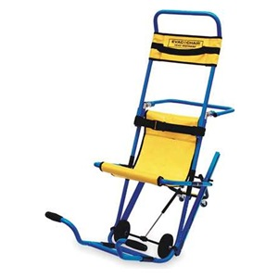
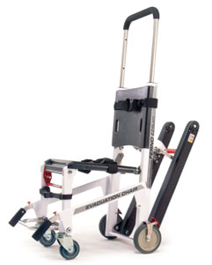
Track-Type Devices
Long Track (Garaventa)
Rear Facing (Glider)
Narrow (AOK)
2-Wheeled (Evac+Chair)
Standard (Ferno EZ-Glide)
16
Notes:
5 Track-type devices were used to represent a variety of track type devices on the market. For the selected devices, the product names are in parentheses – we refer to the device by these generic names.

Slide 17
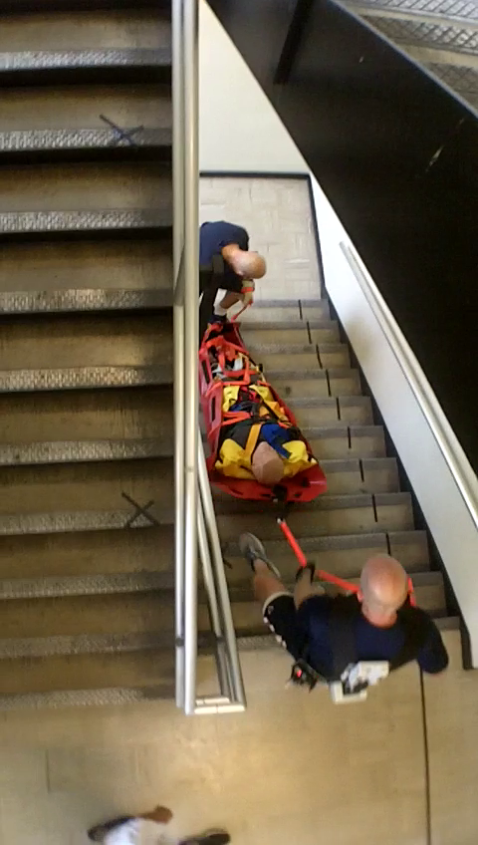
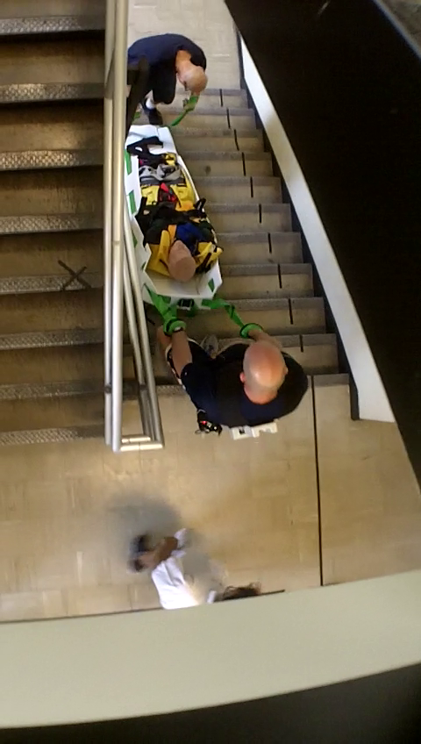
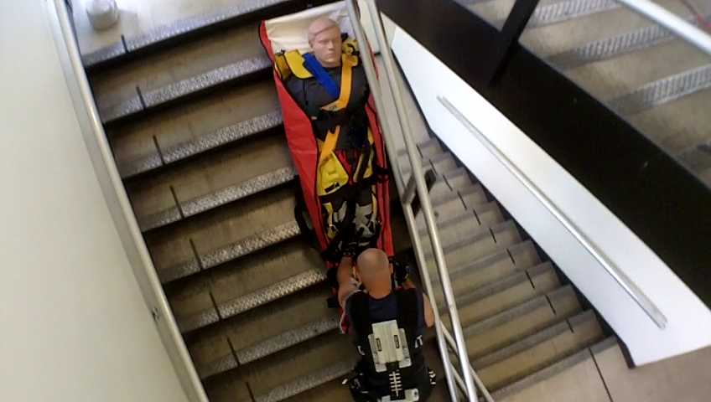
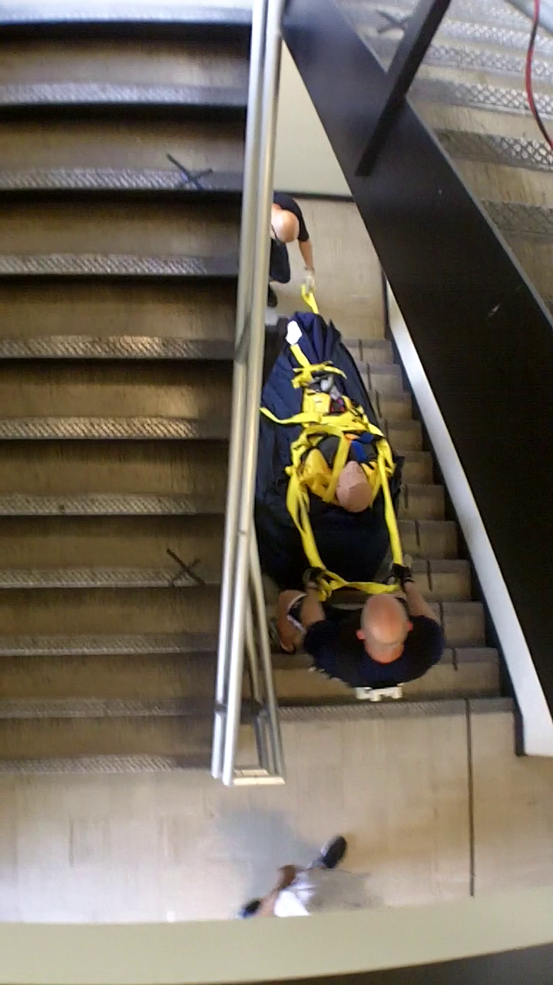
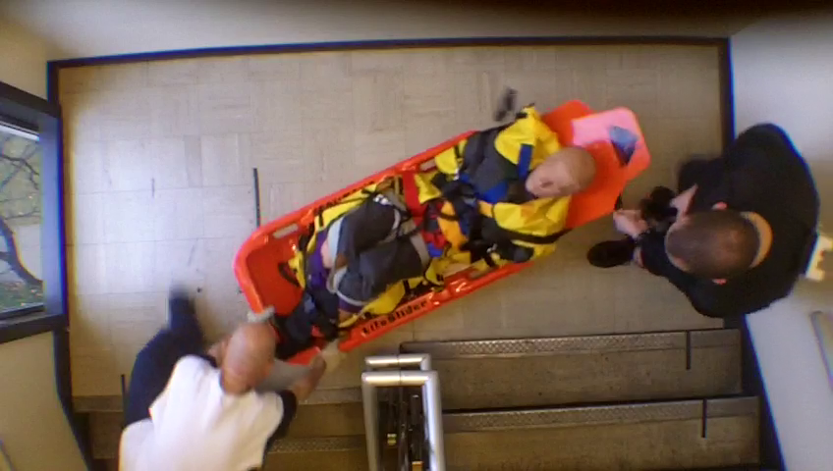
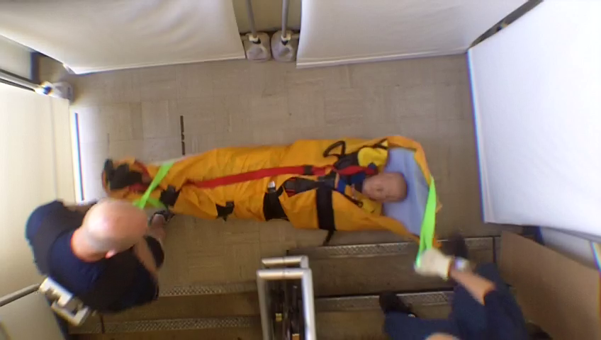
Sled-Type Devices
Roll-up (Med Sled)
Corrugated (Evacuslyde)
Inflatable (Hover Jack)
Wheeled (Subway Sled)
Hardshell (Lifeslider)
Fabric Mat (ResQmat)
17
Notes:
6 sled-type devices were used – each representing different design features. Actual product names are provided in parentheses.

Slide 18
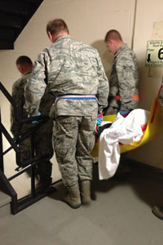
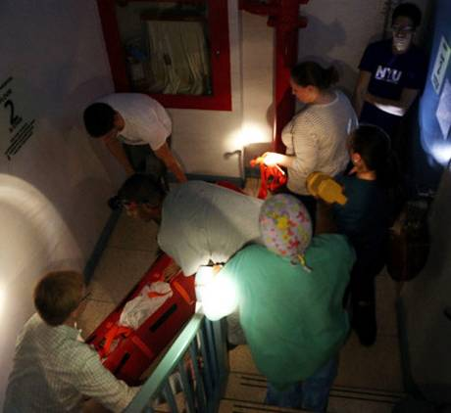
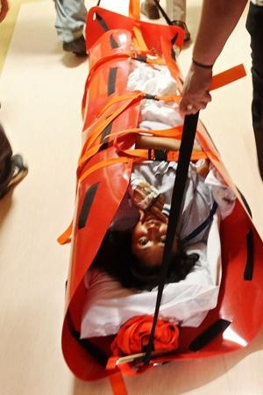
Hurricane Sandy Hits NYC
18
Notes:
Context – Photos from news sites

Slide 19
Staircase Width
Based on NFPA 101-2009 describing staircase widths based on occupant load:
Category | Width (inches) | Capacity (persons) | Code
Narrow | 36 | < 50 | 7.2.2.2.1.2 (A)
Medium | 44 | < 2000 | 7.2.2.2.1.2 (B)
Wide | 56 (52) | >= 2000 | 7.2.2.2.1.2 (B)
19

Slide 20
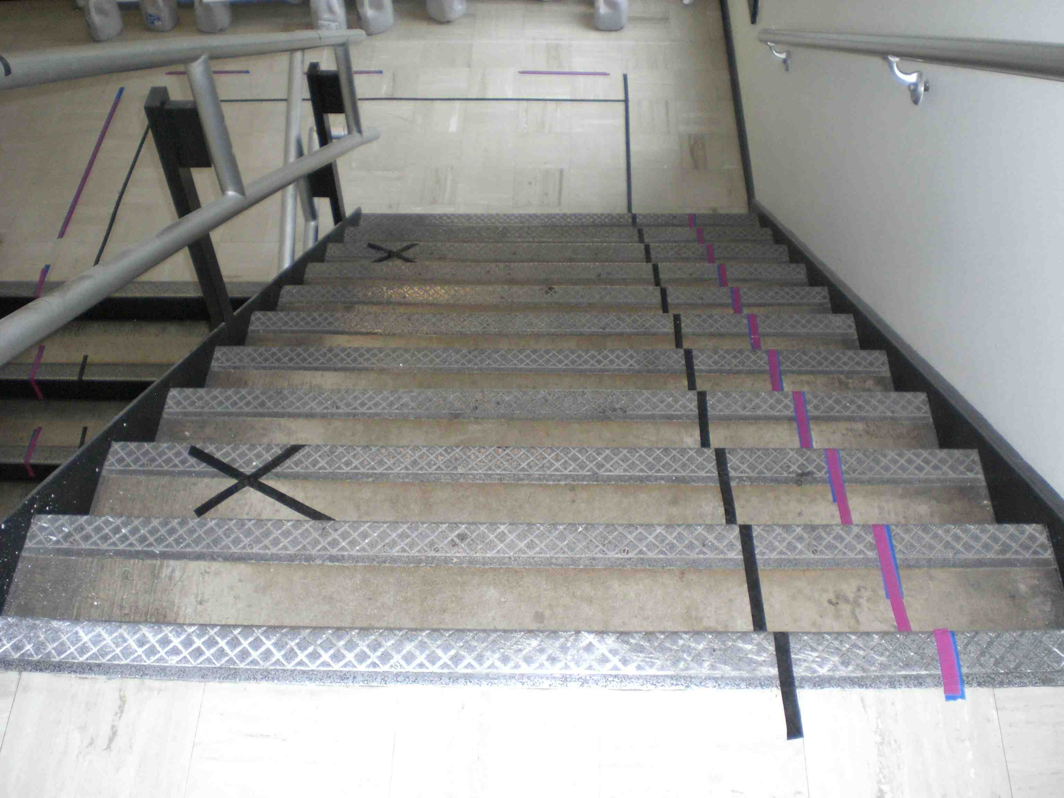
Staircase Width
20
Notes:
Staircase width controlled with tape lines – not an issue given there were no obstructions on the stairs

Slide 21
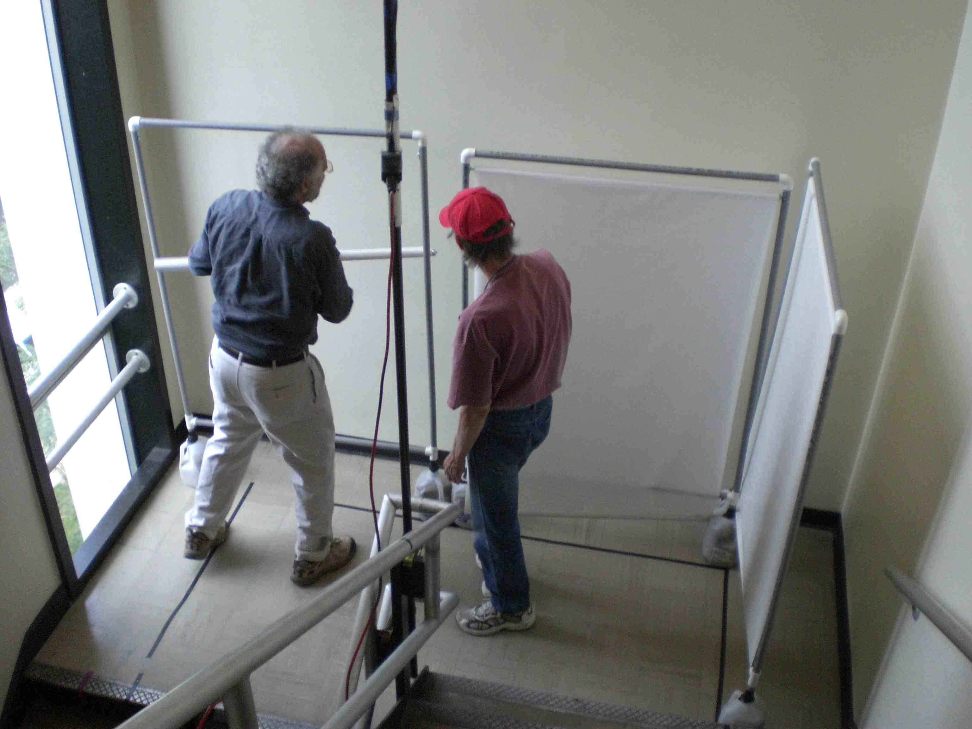
Staircase Width
21
Notes:
Landing width adjustment controlled with movable panels– this did which devices could be used.

Slide 22
Urgency
22
Controlled via instructions given to the subject prior to each run.
  non-urgent - “you can take as much time as you need during this descent”
  urgent - “the situation requires you leave the building as quickly as possible.”
    Repeating recorded message “This is an urgent condition”

Slide 23
Participants-
Recruited from a population of firefighters
Twelve subjects/study- male
  Height: 183 cm (175 – 196 cm)
  Weight: 88 kg (71 – 111 kg)
  Age: 36 yrs (24 – 61 years)
  Experience: 9 yrs (1.5 – 23 years)
Signed IRB approved consent documents

Slide 24
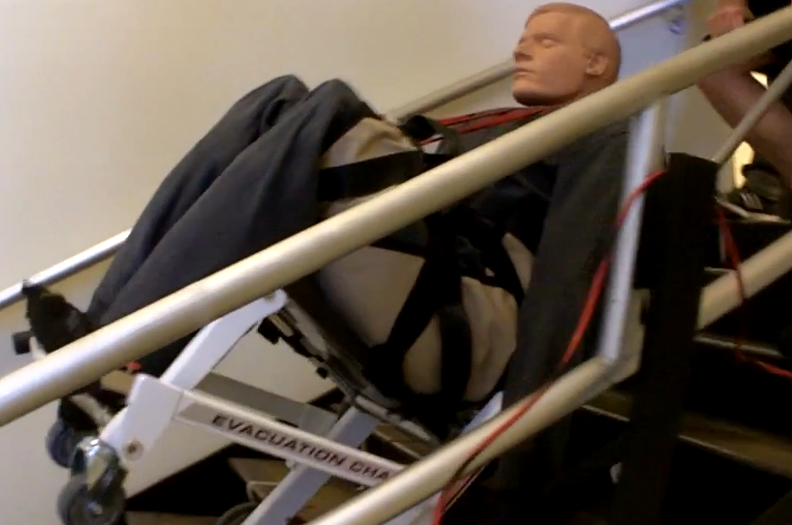
Occupant
Rescue Randy
  Control for size, shape, weight
  73 kg (160 lbs)

Slide 25
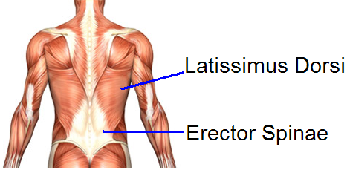
Measures
Duration of evacuation
Electromyography
  Erector Spinae,
  Latissimus Dorsi,
  Deltoid,
  Biceps
Heart Rate
Perceived exertion ratings
Spine motion
Usability information via post study interview.

Slide 26
Perceived Exertion Ratings
“How hard physically was this task for you?”
  0 Not at All
  1 Very Easy
  2 Fairly Easy
  3 Moderate
  4 Somewhat Hard
  5 Hard
  6
  7 Very Hard
  8
  9
  10 Very, Very Hard

Slide 27
Descent Speed Results

Slide 28
Looking Across Studies: Descent Speed as a function of Staircase Width
p<0.001
28
Notes:
Descent speeds were significantly faster on 52-inch wide stairs

Slide 29
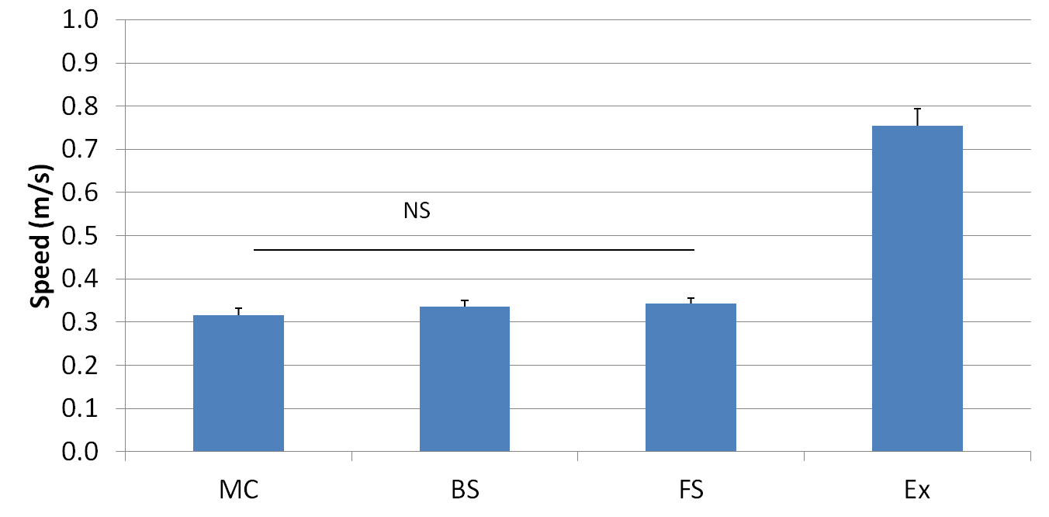
Stair Descent Speeds: Hand-Carried Devices (44” Staircase Width)
Extended Handle
Extended Handle
Extended Handle
Basic Stair Chair
Extended Handle
Basic Stair Chair
Basic Stair Chair
Basic Stair Chair
Fabric Seat
Fabric Seat
Fabric Seat
Manual Carry
Fabric Seat
Manual Carry
Manual Carry
Manual Carry
Range based on samples obtained by Peacock, Hoskins, Kuligowski (2012) Safety Science 50, 1655–1664, table 3.
Fruin, J.J. (1971). Pedestrian Planning and Design, All age average, pg 56.
Notes:
Extended handle stairchair resulted in significantly faster descents and the only hand-carried device that could be used at a speed consistent with pedestrian egress rates.

Slide 30
Stair Descent Speed by Track-Type SDDs: 44 and 52 inch staircase widths
Chair Style
Range based on samples obtained by Peacock, Hoskins, Kuligowski (2012) Safety Science 50 1655–1664, table 3.
Fruin, J.J. (1971). Pedestrian Planning and Design, All age average, pg 56.
Notes:
All track type devices had descent speeds consistent with pedestrian egress speeds. Within this group, the 2-wheel device was significantly faster than the others.

Slide 31
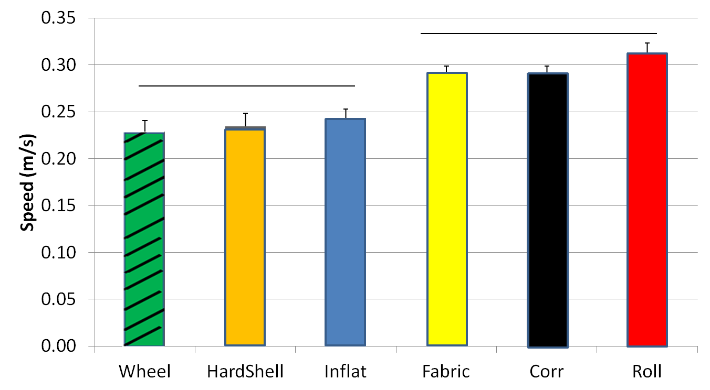
Stair Descent Speed by Sled SDDs: 44 and 52 inch Staircase Widths
Wheeled Hard Shell Inflatable Fabric Mat Corrugated Roll-up
SLED TYPE
p values (Width <0.001 Device <0.001 Device x width = 0.553)
31
Notes:
Rolll-up, corrugated, and fabric mat FASTER than the two one person devices and the inflatable. All are slower than normal pedestrian speeds

Slide 32
Heart Rate Results

Slide 33
Heart Rate – Percent Max –Hand Carried SDDs
Extended Handle
Hand-Carried Stair Descent Device
Notes:
Manual carries showed highest heart rate values. Extended handle had lowest physiologic demands.

Slide 34
Heart Rate – Percent Max-Track-type SDDs
Rear Facing 2-Wheel Long Track Narrow Standard
Device
Notes:
For the track type devices the physiologic demands were lowest for the “standard” chair. Note that these descents are conducted by a single evacuator.

Slide 35
Heart Rate – Percent Max
Sled Type SDDs
% of Age adjusted Maximum Heart Rate
Wheeled Hard Shell Corrugated Roll-up Corrugated Roll-up Fabric Mat Inflatable Inflatable Frabric Mat
(Leader) (Follower) Follower Follower Leader Leader Leader Leader Follower Follower
SLED TYPE / EVACUATOR ROLL
Notes:
Heart rate data for the sled-type devices and the position of the evacuator (leader vs. follower) during the evacuation. Limited differences exist across the devices.

Slide 36
Results – Muscle Use

Slide 37
Hand-Carried SDDs –Stair Data Mean*time, (44” Width)
Erector Spinae Latissimus Dorsi
BC=Basic / FS = Fabric Seat / Ex = Extended Handles / MC = Manual Carry
Notes:
When using hand-carried devices the Erector Spinae back muscles show the highest activation levels across the sampled muscles. The product of the activation level and the duration of the evacuation shows the lowest activation for the extended handle stair chair. This is largely due to the quick descents.

Slide 38
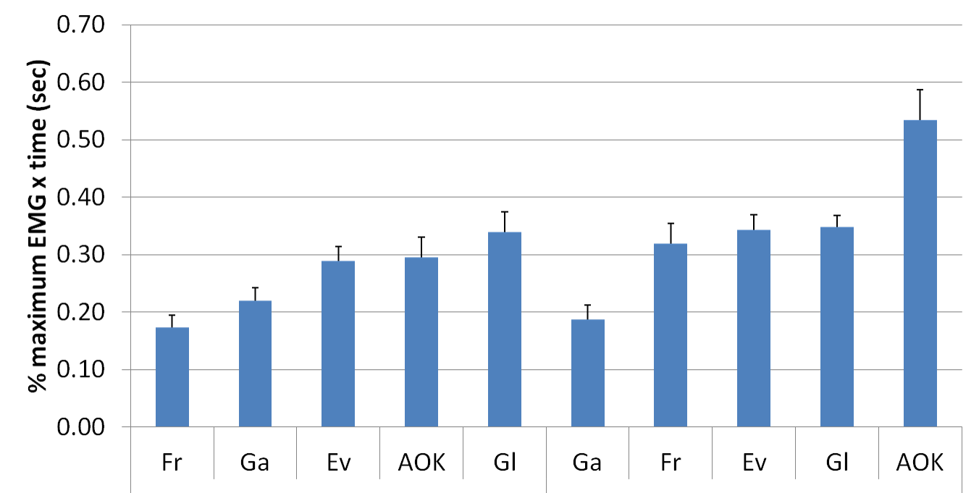
Track Type SDDs: Stair Data Mean*time (1.12 and 1.32m):
Erector Spinae Latissimus Dorsi
Std LT 2-W Nar RF
LT Std 2-W RF Nar
2-W=2-Wheel / Nar = Narrow / Std = Standard/ RF = Rear-Facing / LT = Long-Track
Notes:
Erector Spinae muscle use with the track-type devices is minimized with the standard and long track devices. The Latissimus Dorsi muscle, which is a muscle used in pulling tasks, is least with the long track device on account of its braking system. The narrow device tended to roll easily down the stairs so the participants tended to pull back more which resulted in larger Latissimus Dorsi activation.

Slide 39
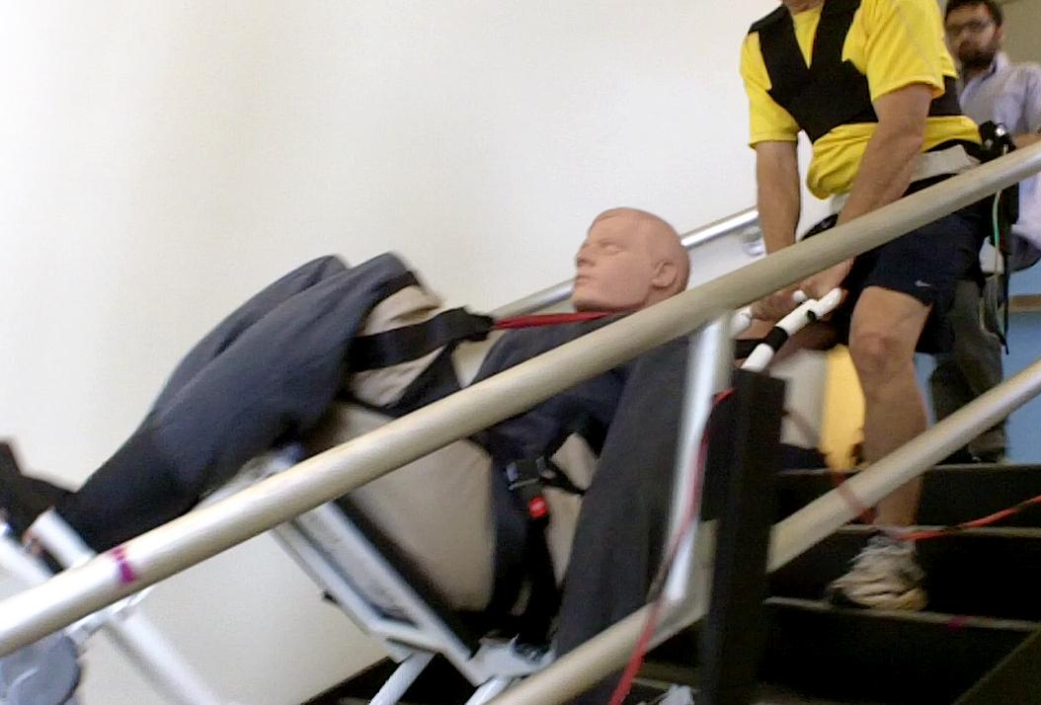
Latissimus Dorsi
Narrow Chair
Notes:
This chart shows where the Latissimus Dorsi muscle is located.

Slide 40
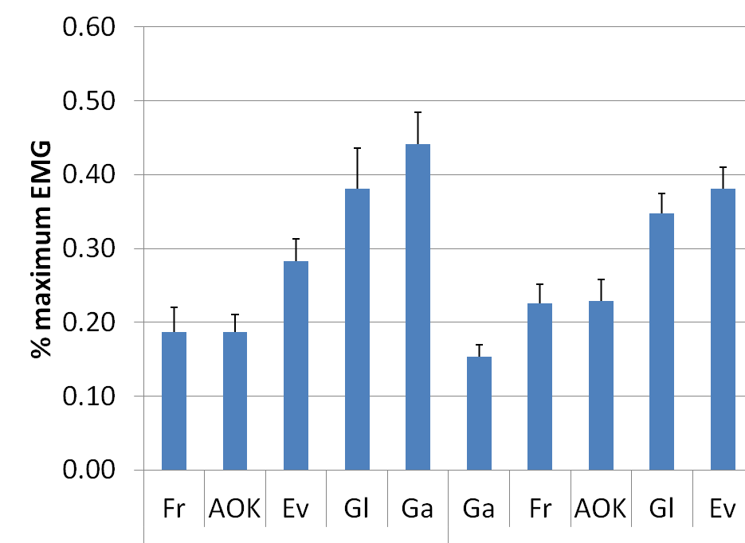
Track Type SDDs: Landing
(1.12 and 1.32m): Arm Muscles - 90th percentile
Deltoid Bicep
Std Nar 2-W LT RF
LT Std Nar RF 2-W
2-W=2-Wheel / Nar = Narrow / Std = Standard/ RF = Rear-Facing / LT = Long-Track
Notes:
On the landing, there were large differences in the use of the shoulder (deltoid) muscles and arm muscles (biceps). The standard and narrow SDDs had lowest shoulder muscle use. The long track device had high shoulder muscle use as the device had to be pushed off the bottom step. The Rear facing had to be lifted and tilted, therein using the shoulders. The rear facing and the 2-wheel devices had significantly higher bicep use since the arms were supporting some of the occupant’s weight during the landings.

Slide 41
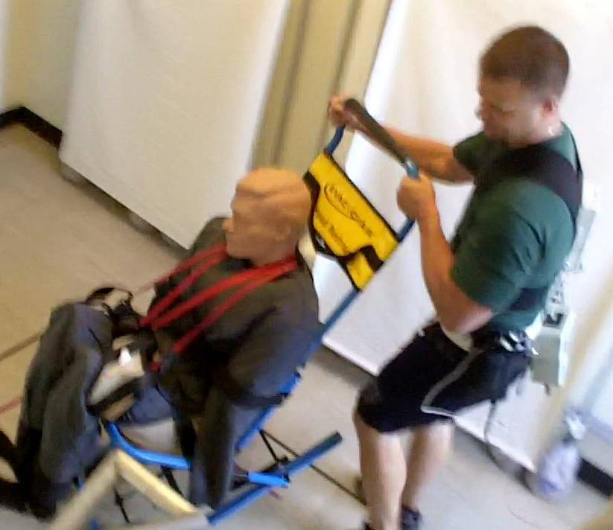
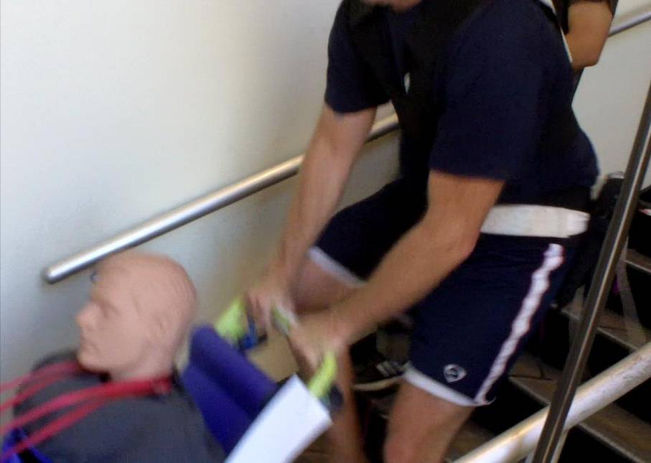
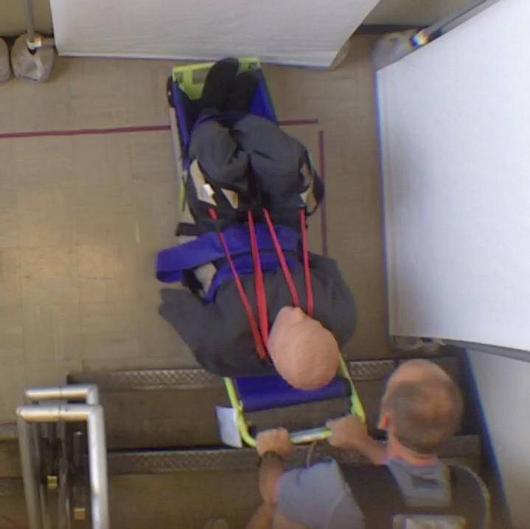
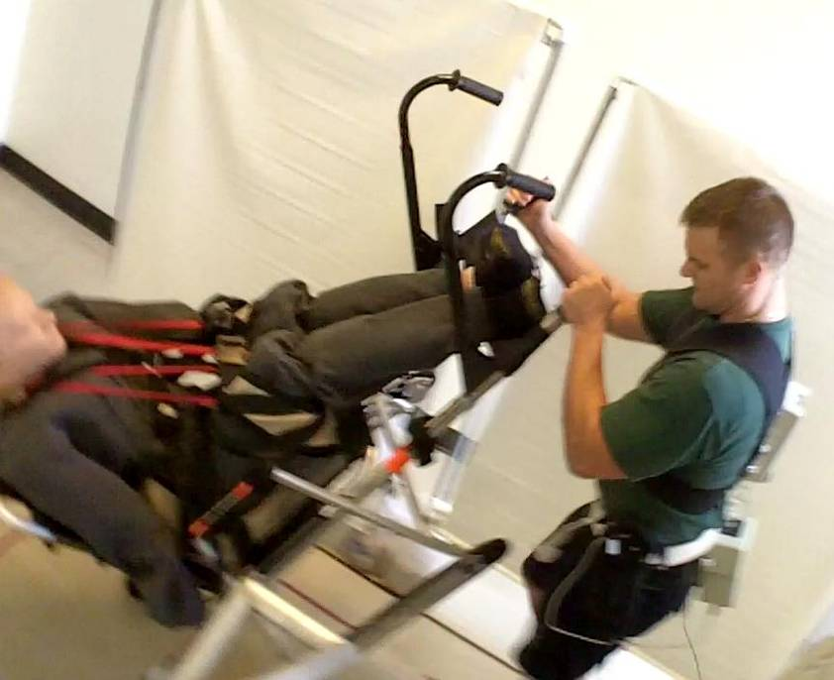
Bicep
Long-Track
2-Wheel
Deltoid
Long-Track
Bicep
Rear-Facing
Deltoid
Deltoid
Notes:
Left side pictures: Deltoid being used to push long-track SDD off bottom stair
Right side pictures: Bicep being used with 2-wheel SDD and Rear-facing SDD- which also used the deltoid.

Slide 42
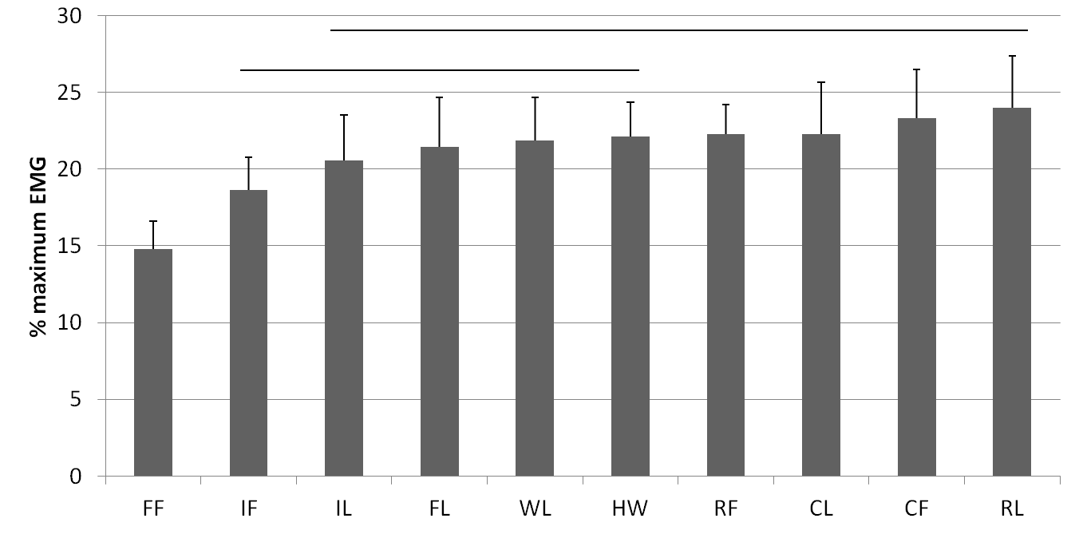




Sled-Type SDDs: Stair Data
Erector Spine (Back) Muscles
Fabric Mat Inflatable Inflatable Fabric Mat Wheeled Hard Shell Roll-up Corrugated Corrugated Roll-up Follower Follower Leader Leader (Leader) (Follower) Follower Leader Follower Leader
SLED TYPE / EVACUATOR ROLE
42
Notes:
Average EMG signal for the Sled type devices - Lowest for the fabric mat in the follower position. The rest were generally similar.

Slide 43
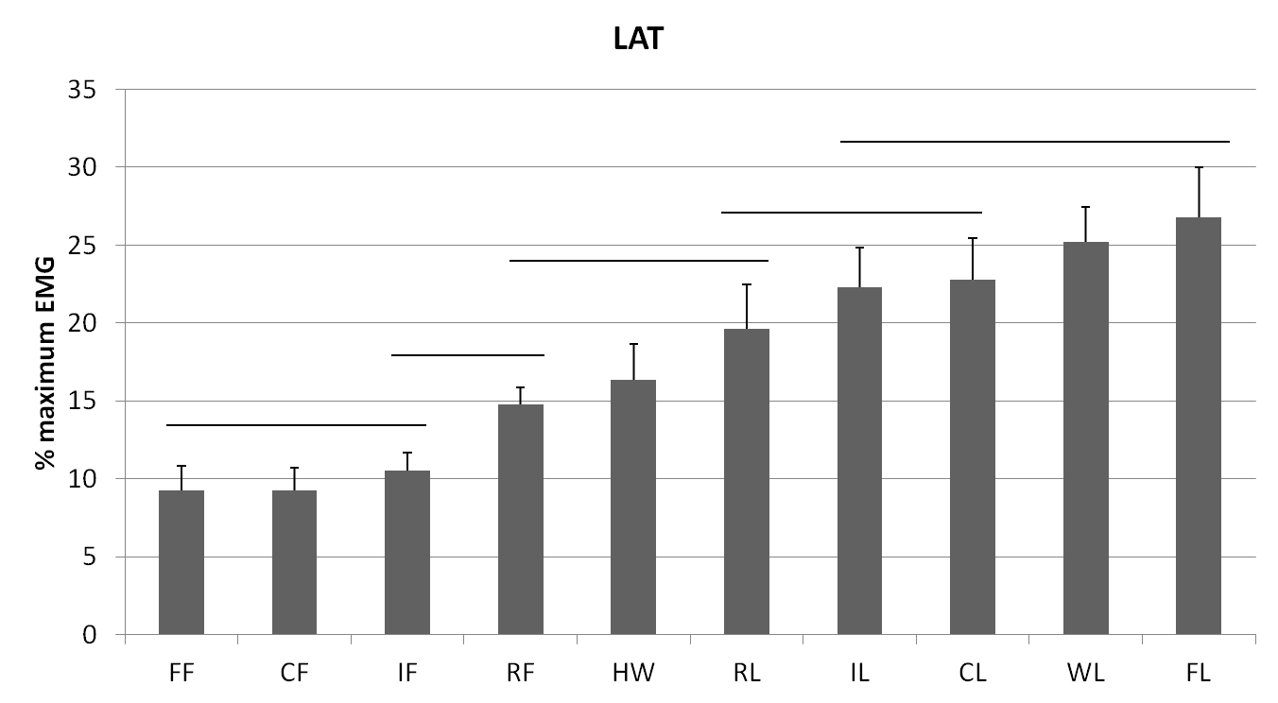
Sled-Type SDDs: Landing Data
Latissimus Dorsi Muscles
Fabric Mat Corrugated Inflatable Roll-up Hard Shell Roll-up Inflatable Corrugated Wheeled Fabric Mat Follower Follower Follower Follower (Follower) Leader Leader Leader (Leader) (Leader)
SLED TYPE / EVACUATOR ROLE
43
Notes:
With sled-type SDDs, much of the hard work was on the landing. Note that the 5 smallest bars are for the follower who could only do a limited amount versus the leader (front position) which had the larger bars.
Among the leader positions, the Hardshell (1 person-behind) and the roll-up tended to be best. Highest was the fabric mat.

Slide 44
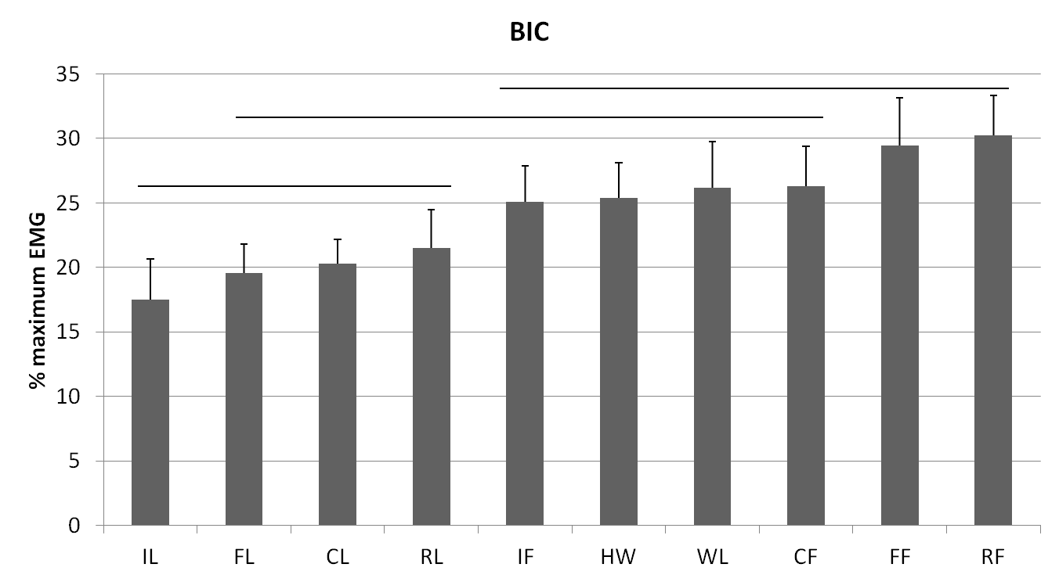
Sled-Type SDDs: Landing Data
Bicep Muscles
Inflatable Fabric Mat Corrugated Roll-up Inflatable Hard Shell Wheeled Corrugated Fabric Mat Roll-up Leader Leader Leader Leader Follower (Follower) (Leader) Follower Follower Follower
SLED TYPE / EVACUATOR ROLE
44
Notes:
With Sled-type SDDs there is a fair amount of Bicep use on the landing – general trend - less by the leaders and more by the followers.

Slide 45
Objective Measures - Analysis Summary
Device | Positives | Negatives
Hand-Carried | Less Expensive | Higher Physical Demands Slower – Unless lead person can face forward
Track-type | Reduced Back muscle use – Faster | Latissimus use – on stairs, landings
Sled-type | Low muscle demands on stairs. | Transfer in/out, High demands on Landing

Slide 46
Hand-Carried SDDs-Interviews

Slide 47
Track-type SDDs - Interviews

Slide 48
Sled Type SDDs– Interviews
Device | Corrugated | Fabric Mat | Hard Shell | Inflatable | Roll-up | Wheeled
Positive Design Features | 2-Handle straps – good length Easy to get around corner Low profile | Wide Strap- Good length Good Friction Easy to get around corner | None | None | More rigid – less lateral swing Easy to get around corner | Friction from material
Negative Design Features | Length makes getting around corner tough | None | Lack of control Hard to turn Strap to long Strap could slip | Top heavy- tendency to tip Hard to get around corner Bulky | Could slide to fast Long thin strap difficult to grip* | Position of single operator in front of patient / Bending Head-end swing on landing, Awkward to push down on patient’s legs
% that would Recommend* Fire service / Building owners | 42% / 67% | 50% / 58% | 0% / 25% | 0% / 25% | 58% / 58% | 8% / 25%
48

Slide 49
Consumer Opinion Study
2 Components
  First Impressions
    Collect initial perceptions of the 13 devices used in the prior studies
    Asked which, if any, devices they would like to try
  Post descent impressions
    Participants will be taken down 2 flights of stairs in up to 5 different devices.

Slide 50
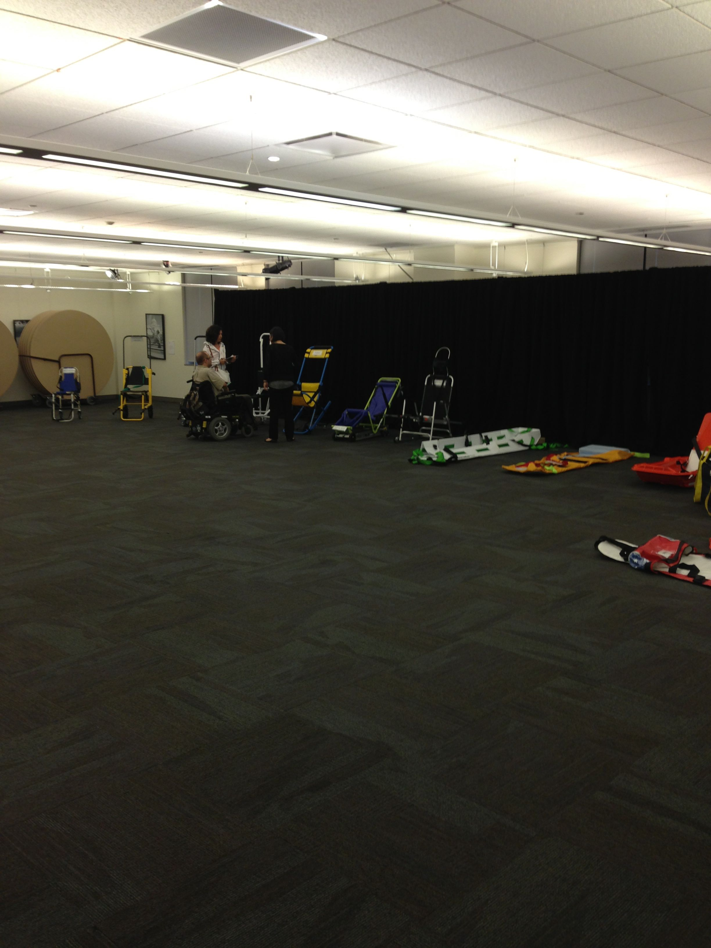
Initial Impression Survey
Transfers
Safety
Security
Nervousness
Notes:
Access Living conference room with devices available for viewing.

Slide 51
Initial Impression Survey
1. How easy would it be for you to transfer into the device?
very difficult / difficult / somewhat difficult/ somewhat easy / easy / very easy
2. How easy would it be for you to transfer out of the device?
very difficult / difficult / somewhat difficult/ somewhat easy / easy / very easy
3. How safe would you feel riding in this device?
very unsafe / unsafe / somewhat unsafe / somewhat safe / safe / very safe
4. How securely do you think the straps would hold you?
very unsecurely / unsecurely / somewhat unsecurely / somewhat securely / securely / very securely
How nervous would you be about riding in the device?
very nervous / nervous / a little nervous / not at all nervous

Slide 52
Post-Ride Survey
1. How easy was it for you to transfer into the device?
very difficult / difficult / somewhat difficult/ somewhat easy / easy / very easy
2. How easy was it for you to transfer out of the device?
very difficult / difficult / somewhat difficult/ somewhat easy / easy / very easy
3. How safe did you feel riding in this device?
very unsafe / unsafe / somewhat unsafe / somewhat safe / safe / very safe
4. How securely did the straps would hold you in the device?
very unsecurely / unsecurely / somewhat unsecurely / somewhat securely / securely / very securely
After having ridden in this device, how nervous would you be if we asked you to repeat the ride in the device?
very nervous / nervous / a little nervous / not at all nervous
6. For an emergency evacuation, were you sufficiently comfortable riding in the device? (Y/N)

Slide 53
After the completion of all rides selected by a participant…
Which of these devices would be acceptable to you for emergency evacuation from a multi-story building?
Are there any specific design features you liked or disliked about the devices you rode in today? Please explain.
Is there anything else you would like to tell us about the devices you have seen today?

Slide 54
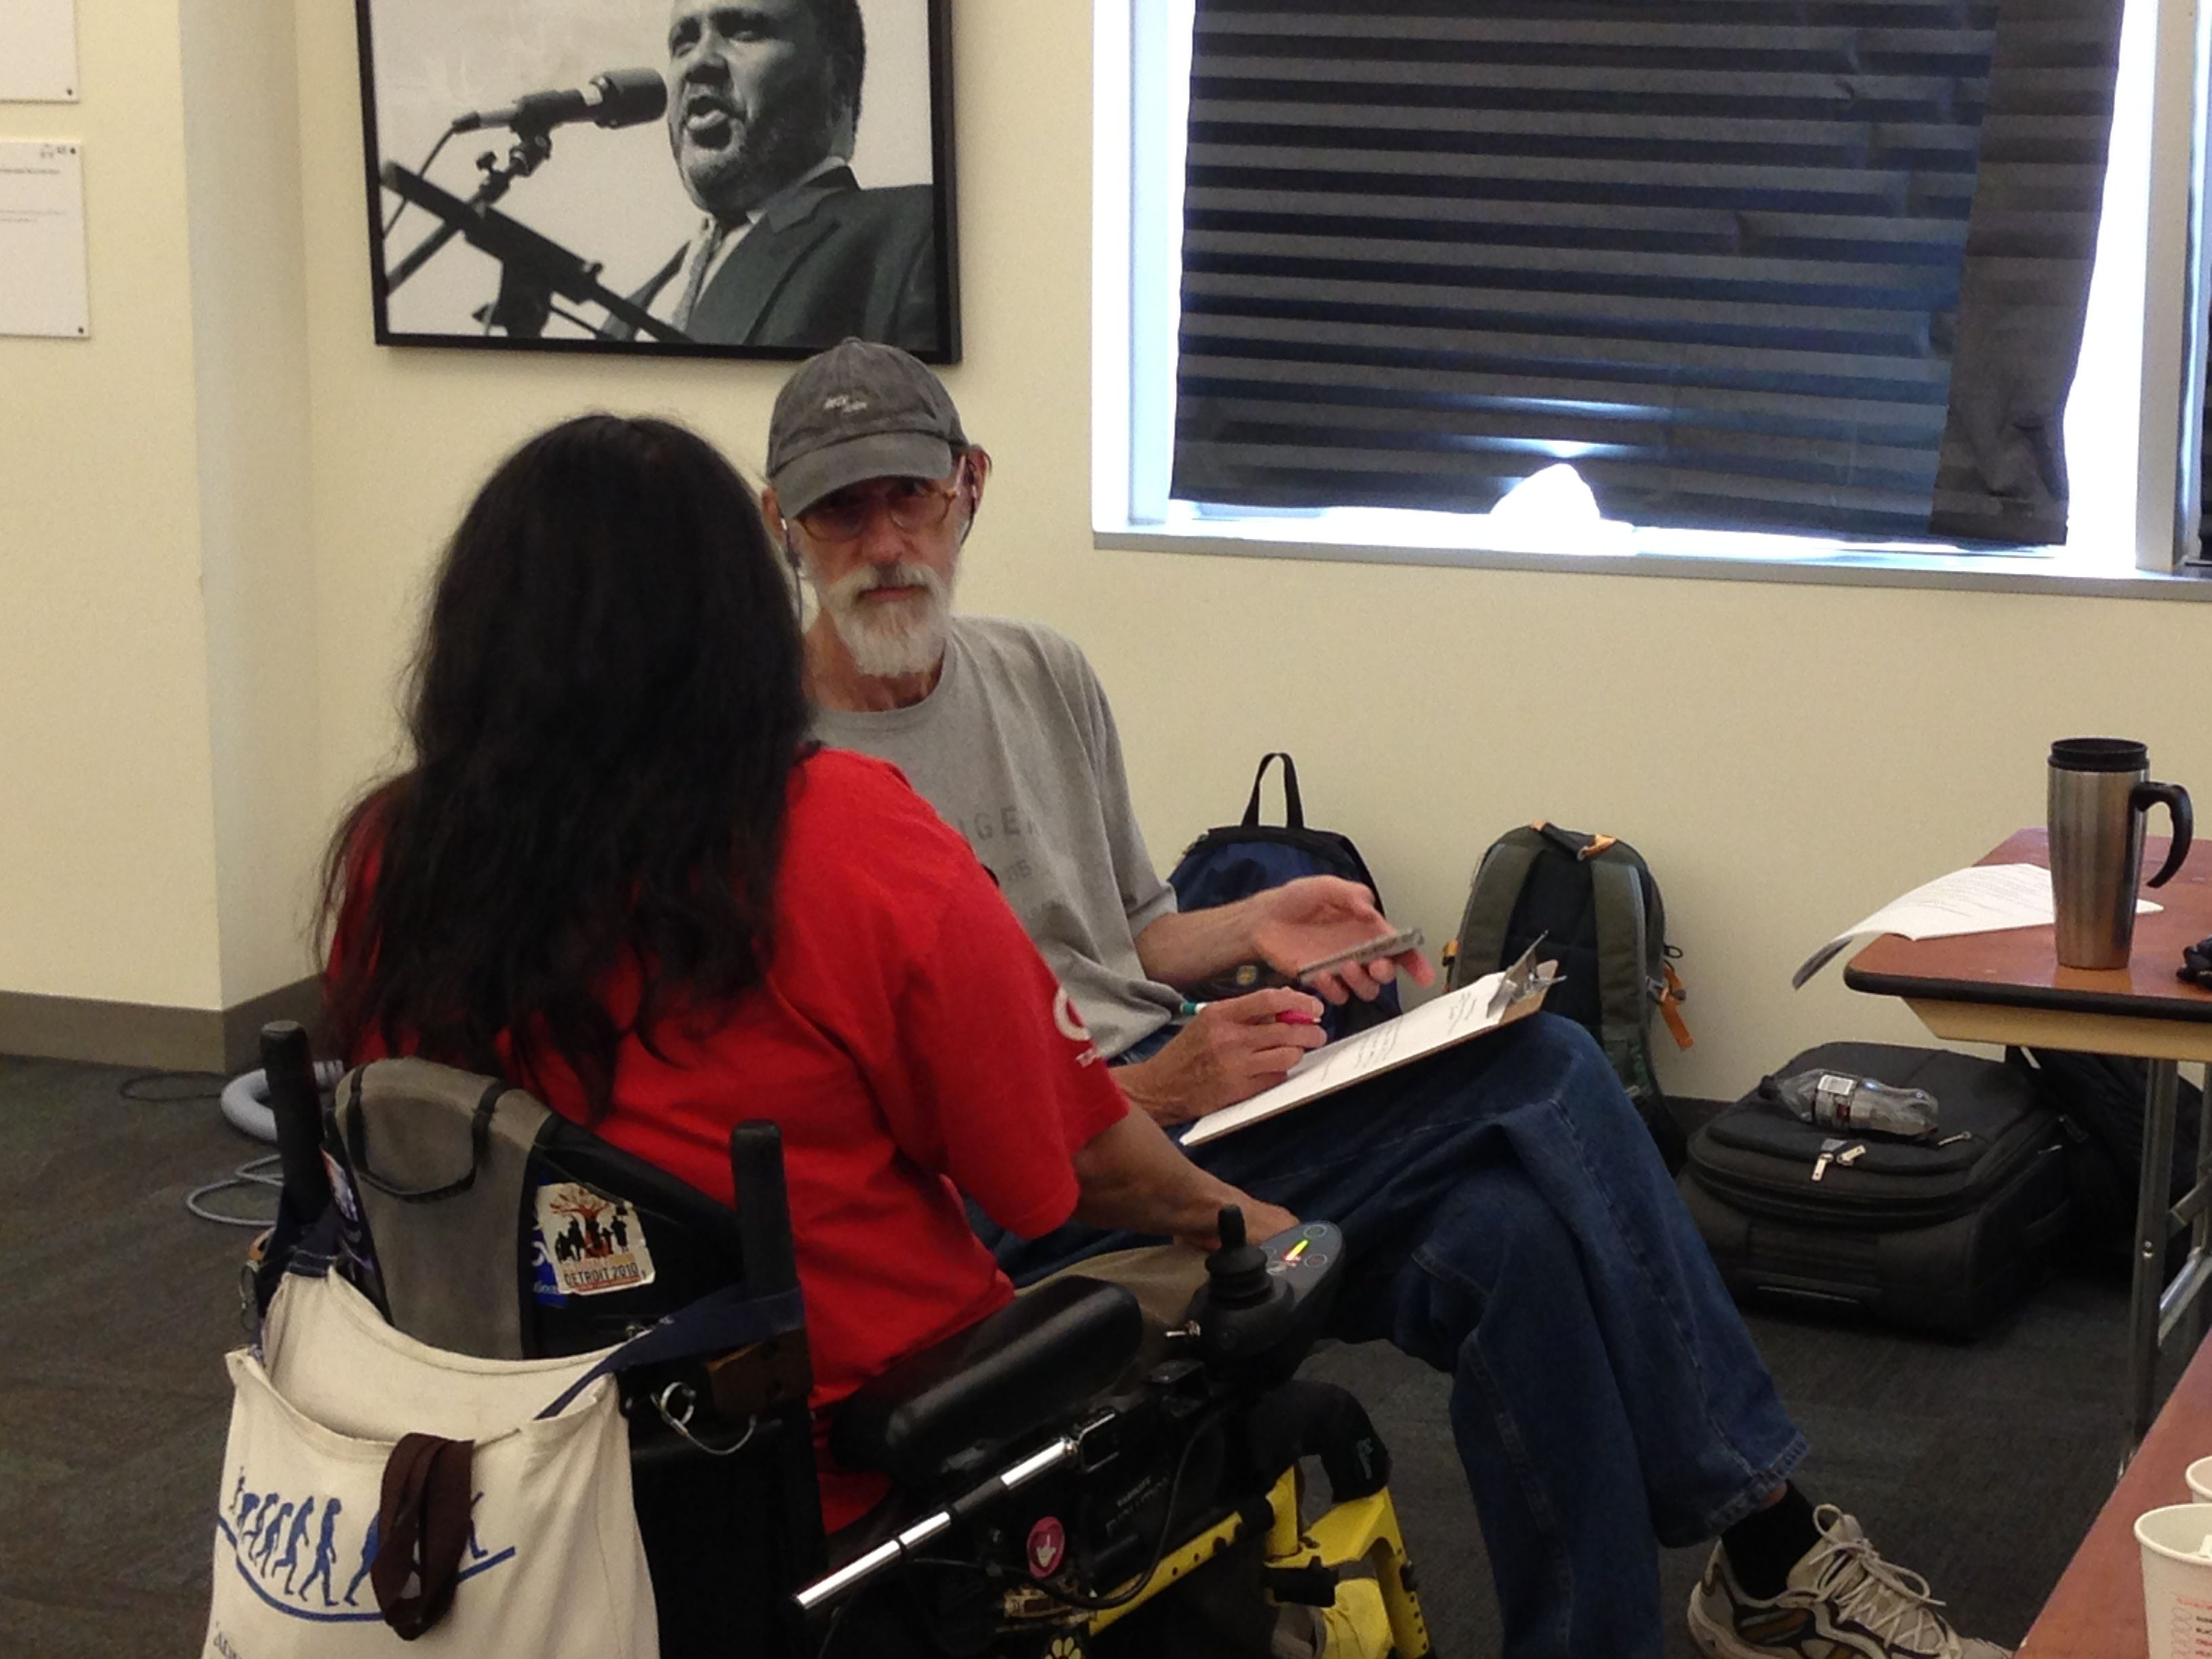
Participants
Total
  14 participants
    8 male
    6 female
Age range
    29 – 63 years (avg. 49.2 years)
Weight
    106 – 365 lb (avg. 208.6 lb)
Notes:
Participant being interviewed by research team member.

Slide 55
Participants
Disabilities
  Amputation, arthritis, CVA, diabetes, hearing impairment, low back pain, low vision, paraplegia, quadriplegia, post-polio, spina bifida
Mobility aids
  Cane, walker, manual wheelchair, powered wheelchair, prostheses
Notes:
Participant being interviewed by research team member.

Slide 56
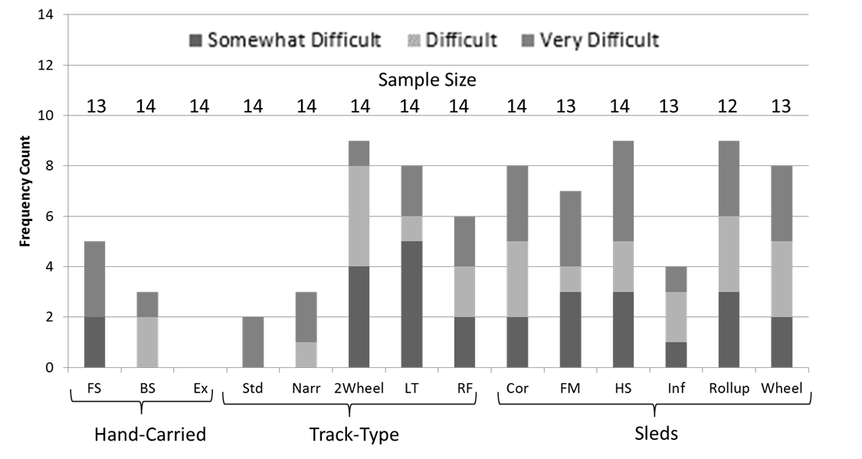
Initial Impressions
Transfers In/Out- Easiest for Carry-Type and 4 wheeled track type
Notes:
Mannequin being transported by Fabric Seat.

Slide 57
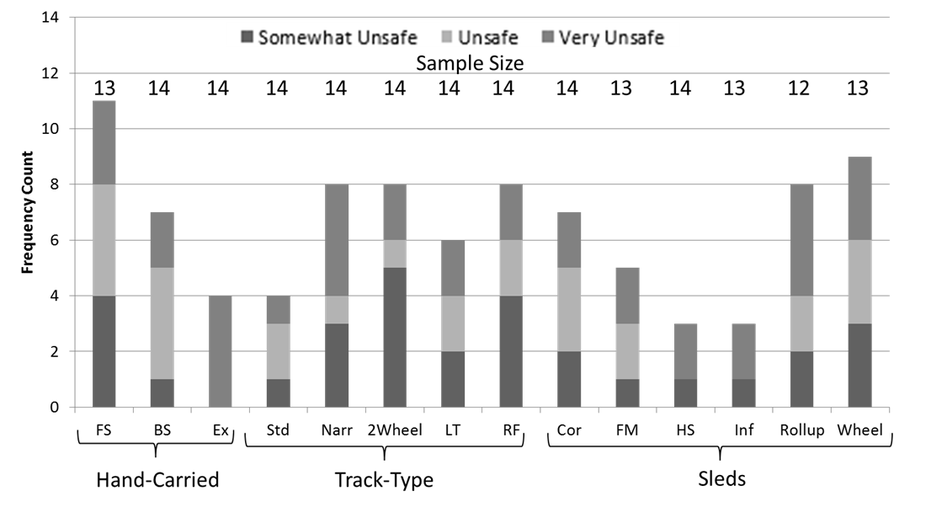
Initial Impression
Safety
  Concern over carrying full weight
  Raised edges of Hardshell and Inflatable added to safety
Notes:
Top right, mannequin being transported via Fabric Seat. Bottom right, mannequin being transported by Extended Handle.

Slide 58
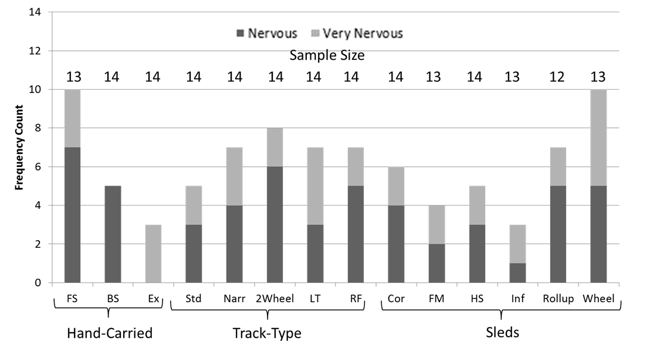
Initial Impression
Nervousness
Notes:
Top right, mannequin being transported via Hardshell. Bottom right, mannequin being transported via Inflatable.

Slide 59
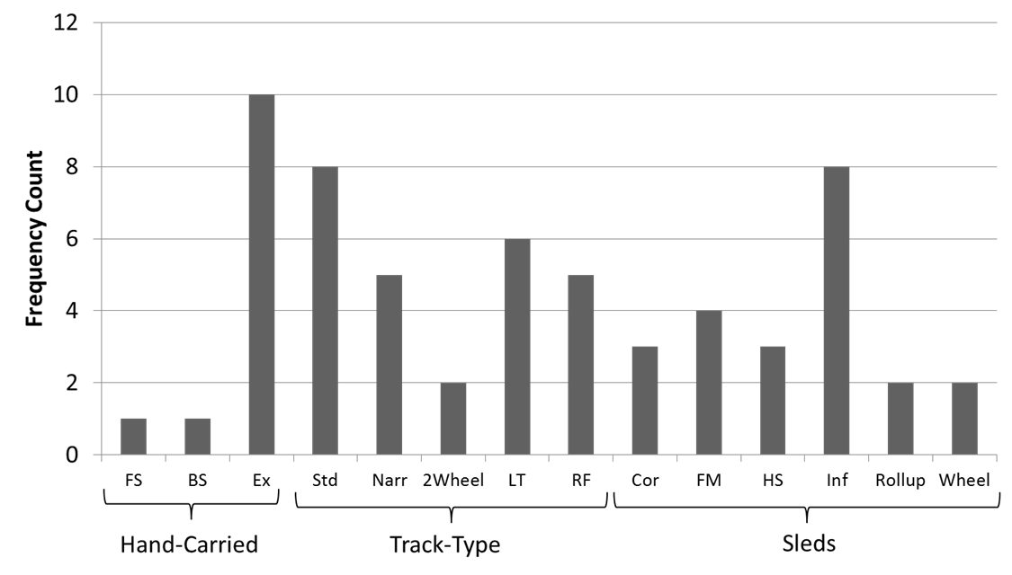
Which of these devices would be acceptable in emergency evacuation situation?
Notes:
Track-type, standard evacuation chair.

Slide 60
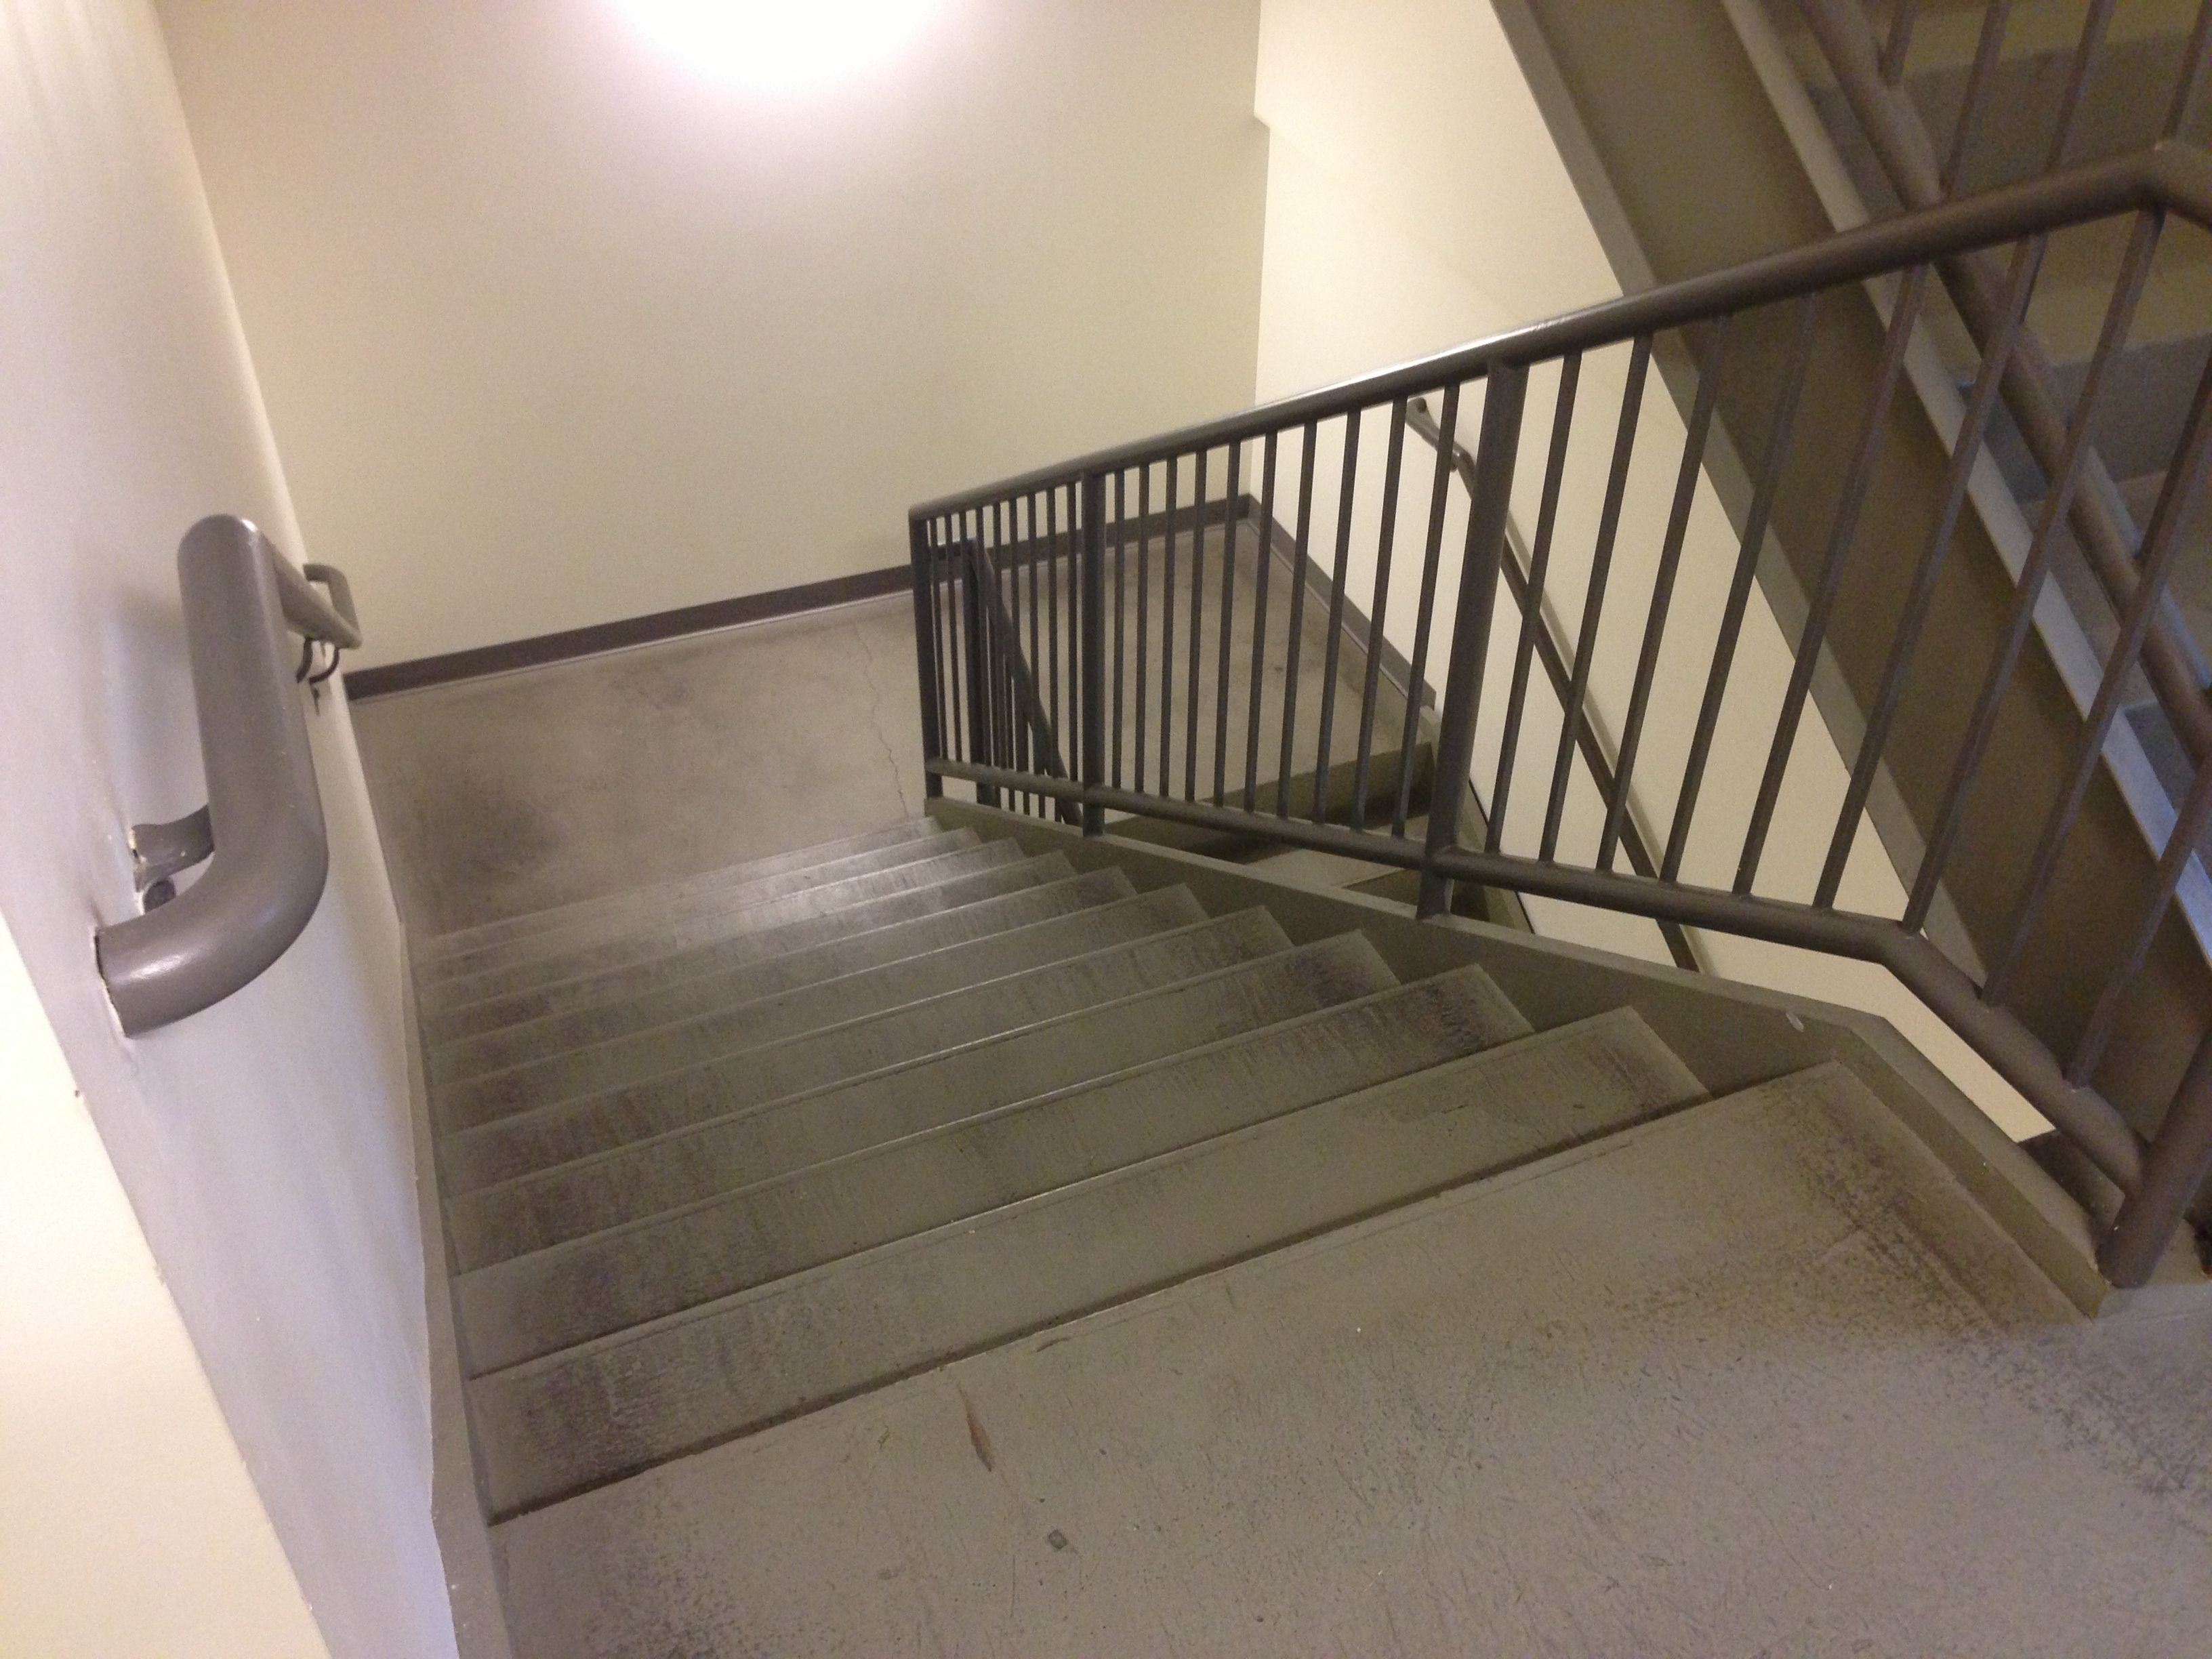
Post-Ride
Transfer in and out
  Same or improved
Nervousness
  Same or improved
Security
  Same or improved
Safety
  Less safe (2)
  Unchanged (5)
  More safe (2)
Trial use
  Opinion changed in half of instances
Notes:
Access Living stairway with middle landing.

Slide 61
Consumer preference (acceptable) rating vs. operator % maximum heart rate

Slide 62
Overall Study Limitations
Weight of the occupant in FF trials
Relatively short duration evacuations

Slide 63
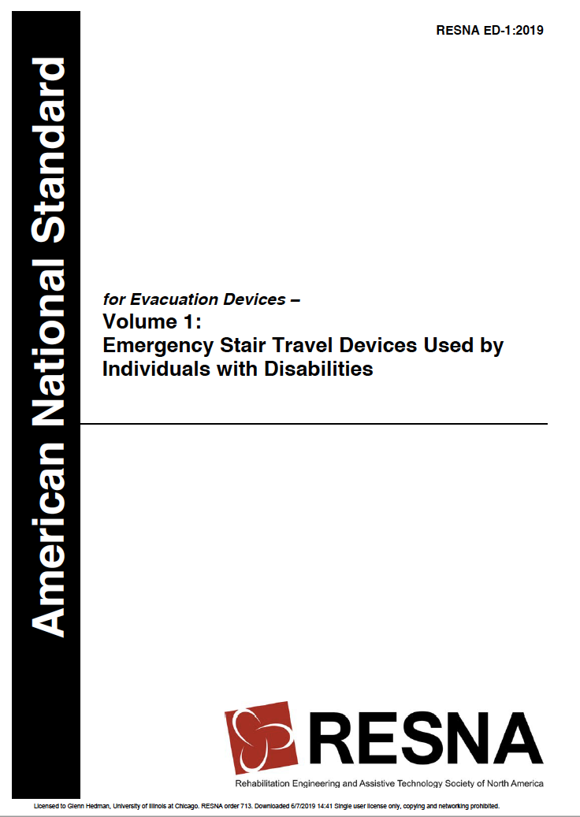

Slide 64
Key points re: 2019 Standard
Performance tests broadened to apply to any design type
Content broken up into 2 sections
  Section 1
    Terminology, Description, & Performance
  Section 2
    Inspection, Installation, & Maintenance

Slide 65

Key points re: 2019 Standard
Section 1
  Occupant features
  Weight capacity
  Stability
  Maneuverability

Slide 66

Key points re: 2019 Standard
Section 2
  Storage location
  Inspection schedule
  Maintenance

Slide 67

Weight Capacity
Occupant features
  Weight capacity
    350 lb (159 kg), min.
  Test method
    1.5 x weight capacity
      350 lb, test at 525 lb

Slide 68

Weight Capacity
Occupant features
  Weight capacity
    350 lb (159 kg), min.
  Test method
    1.5 x weight capacity
      350 lb, test at 525 lb

Slide 69

Weight Capacity
Occupant features
  Weight capacity
    350 lb (159 kg), min.
  Test method
    1.5 x weight capacity
      350 lb, test at 525 lb

Slide 70

Stability
Stability
  Configuration for travel on Horizontal Surfaces
    Forward: 10 degrees

Slide 71

Stability
Stability
  Configuration for travel on Horizontal Surfaces
    Forward: 10 degrees

Slide 72

Stability
Stability
  Configuration for travel on Horizontal Surfaces
    Lateral: 10 degrees

Slide 73

Stability
Stability
  Configuration for travel Downward
    Forward: 32.5 degrees

Slide 74

Maneuverability
Perform 180-degree turn through code-compliant stairway and landing
Device loaded with mannequin
Contact with partitions is allowed

Slide 75

Key points re: 2019 Standard
Section 1
  Occupant features
  Weight capacity
  Stability
  Maneuverability

Slide 76

Key points re: 2019 Standard
Section 2
  Storage location
  Inspection schedule
  Maintenance

Slide 77
Summary re ANSI/RESNA ED-1
2019 Edition has been approved by RESNA and ANSI
Covers devices made available January 1, 2020 and after
Devices of any design type can be tested for compliance
Sec 01 for Performance
Sec 02 for Installation & Inspection

Slide 78
Summary- Evacuation Tests
Track-type devices preferred
  Evacuation speed
  Physical Demands
  Ingress / Egress for occupant
If a hand-carried device is used - device width and handles should support lead person descending facing forwards.
Sled-type devices – acceptable for evacuator but getting in/out is a concern for the occupant.

Slide 79

Acknowledgement
Federal Emergency Management Agency Assistance to Firefighters Grant Program
  2009-EMW-FP-01944

Slide 80
Questions?
Further contact:
  Steve Lavender: lavender.1@osu.edu
Glenn Hedman (UIC)
  312-413-7784
  GHedman@uic.edu
Yvonne Meding (RESNA AT Standards Secretary)
  703-524-6686, x403
  YMeding@resna.org

